Slide 1
Distributed File Systems

Slide 2
Organization
General concepts
  Introduction
NFS
AFS
CODA

Slide 3
Introduction
The main purposes of using file in operating systems are:
  Permanent storage of information
  Sharing the information: A file can be created by one application and the shared with different applications.
A file system is a subsystem of an operating system that perform file Management activities such as organization, storing, retrieval, naming, Sharing and protection of files.

Slide 4
What Distributed File Systems Provide
Access to data stored at servers using file system interfaces
What are the file system interfaces?
  Open a file, check status of a file, close a file
  Read data from a file
  Write data to a file
  Lock a file or part of a file
  List files in a directory, create/delete a directory
  Delete a file, rename a file, add a symlink (is a special type of file that contains a reference to another file or directory in the form of an absolute or relative path ) to a file
  etc

Slide 5
Why DFSs are Useful
Data sharing among multiple users
User mobility
Location transparency
Backups and centralized management

Slide 6
Cont…
Clients and Servers:
Clients access files and directories that are provided by one or more file servers.
File Servers provide a client with a file service interface and a view of the file system
Servers allow clients to perform operations from the file service interface on the files and directories
Operations: add/remove, read/write
Servers may provide different views to different clients

Slide 7
Cont…
A DFS provide three types of services, that can be considered as a Component of the system.
  Storage service
  True file service
  Name service. Also called directory service

Slide 8
Desirable features
A good distributed file system should have the following features.
Transparency:- Between the different types of transparency as previously detailed :
  Location: a client cannot tell where a file is located, where the name of a file does not reveal any hint of the file's physical storage location.
    Location transparent: location of the file doesn’t appear in the name of the file
    ex: /server1/dir1/file specifies the server but not where the server is located -> server can move the file in the network without changing the path
  Migration: a file can transparently move to another server
  Replication: multiple copies of a file may exist
  Concurrency: multiple clients access the same file

Slide 9
Cont…
Flexibility: In a flexible DFS, it must be possible to add or replace file servers.
Also, a DFS should support multiple underlying file system types (e.g., various Unix file systems, various Windows file systems, etc.)

Slide 10
Cont…
Reliability:
Consistency: employing replication and allowing concurrent access to files may introduce consistency problems.
Security: clients must authenticate themselves and servers must determine whether clients are authorized to perform requested operation. Furthermore communication between clients and the file server must be secured.
Fault tolerance: clients should be able to continue working if a file server crashes. Likewise, data must not be lost and a restarted file server must be able to recover to a valid state.

Slide 11
Cont…
Performance: In order for a DFS to offer good performance it may be necessary to distribute requests across multiple servers.
Multiple servers may also be required if the amount of data stored by a file system is very large.

Slide 12
Cont…
Scalability: A scalable DFS will avoid centralized components such as a centralized naming service, a centralized locking facility, and a centralized file store.
A scalable DFS must be able to handle an increasing number of files and users.
It must also be able to handle growth over a geographic area (e.g., clients that are widely spread over the world), as well as clients from different administrative domains.

Slide 13
Cont…
Another features are:
  User mobility
  Simplicity and ease of use
  High availability
  High reliability
  Security
  Heterogeneity

Slide 14
Accessing Remote Files
There are several models to service a client’s file access request when the accessed file is a remote file
  Remote service model:- The client’s request is performed at the server’s node.
  Data-caching model :-It attempts to reduce the amount of network
  traffic by taking advantage of the locality feature found in file access. The client’s request is performed at the client’s node itself by using the cached data. Compared with remote service model, this model greatly reduces network traffic.
Almost all existing distributed file systems implement some form of caching.
One problem, referred to as the cache consistency problem the cached data consistent with the original file content.

Slide 15
Units of Data Transfer
In the systems that use the data-caching model, an important issue is to decide the unit of data transfer. The other models are:
File-level transfer model. In this model, when an operation requires file data to be transferred across the network in either direction between a client and a server, the whole file is moved.
Block-level transfer model. In this model, file data transfers across the network between a client and a server take place in units of file blocks.
Byte-level transfer model. In this model, file data transfers across the
network between a client and a server take place in units of bytes.
Record-level transfer model. In this model, the transference unit is the record.

Slide 16
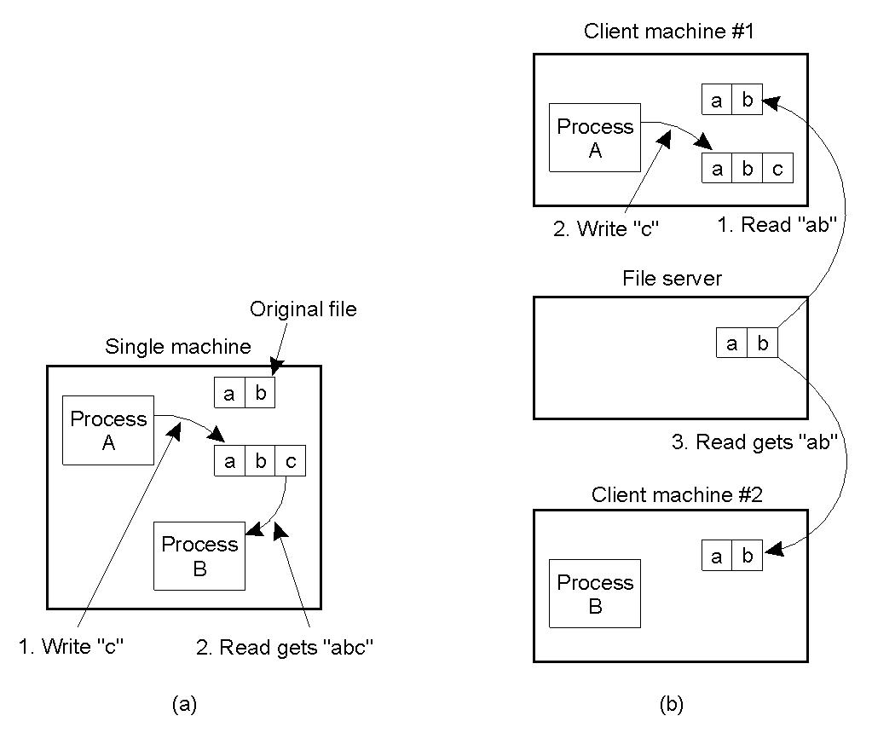
Semantics of File Sharing
(a) On a single processor, when a read follows a write , the value returned by the read is the value just written.
(b) In a distributed system with caching, absolute values may be returned.

Slide 17
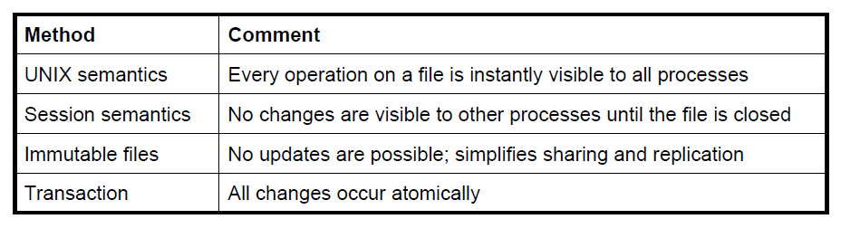
Cont….
Four ways of dealing with the shared files in a distributed system.

Slide 18
Semantics of File Sharing . Unix
Every operation on a file is instantly visible to all parties
A Read following a Write will return the value just written
  For all users of the file
Enforces (requires) a total global order on all file operations to return most recent value
  On a single physical machine this results from using a shared I-Node to control all file operations
  File data is thus shared data structure among all users
Distributed fileserver must replicate this behavior

Slide 19
Semantics of File Sharing . Unix
Distributed UNIX Semantics
  Could use a single centralized server which would thus serialize all file operations
  Provides poor performance
In the case of a DFS, it is possible to achieve such semantics if there is only a single file server and no client-side caching is used.
In practice, such a system is unrealistic because caches are needed for performance and write-through caches are expensive.
Furthermore deploying only a single file server is bad for scalability.
Because of this it is impossible to achieve Unix semantics with distributed file systems.

Slide 20
Semantics of File Sharing . Session
In the case of session semantics, changes to an open file are only locally visible.
Only after a file is closed, are changes propagated to the server (and other clients).
This raises the issue of what happens if two clients modify the same file simultaneously.
It is generally up to the server to resolve conflicts and merge the changes.
Another problem with session semantics is that parent and child processes cannot share file pointers if they are running on different machines.

Slide 21
Semantics of File Sharing . Inmutable files
Immutable files cannot be altered after they have been closed.
In order to change a file, instead of overwriting the contents of the existing file a new file must be created.
This file may then replace the old one as a whole.
This approach to modifying files does require that directories (unlike files) be updatable.
Problems with this approach include a race condition when two clients try to replace the same file as well as the question of what to do with processes that are reading a file at the same time as it is being replaced by another process.

Slide 22
Semantics of File Sharing . Atomic Transactions
In the transaction model, a sequence of file manipulations can be executed indivisibly, which implies that two transactions can never interfere.
Changes are all or nothing
  Begin-Transaction
  End-Transaction
System responsible for enforcing serialization
  Ensuring that concurrent transactions produce results consistent with some serial execution
  Transaction systems commonly track the read/write component operations
Familiar aid of atomicity provided by transaction model to implementers of distributed systems
  Commit and rollback both very useful in simplifying implementation
This is the standard model for databases, but it is expensive to implement.

Slide 23
Caching
Caching is often used to improve the performance of a DFS.
In a DFS caching involves storing either a whole file, or the results of file service operations.
Caching can be performed at two locations: at the server and at the client.
Server-side caching makes use of file caching provided by the host operating system. This is transparent to the server and helps to improve the server’s performance by reducing costly disk accesses.

Slide 24
Cont…
Client-side caching comes in two flavours: on-disk caching, and in-memory caching.
On-disk caching involves the creation of (temporary) files on the client’s disk. These can either be complete files (as in the upload/download model) or they can contain partial file state, attributes, etc.
In-memory caching stores the results of requests in the client-machine’s memory. This can be process-local (in the client process), in the kernel, or in a separate dedicated caching process.

Slide 25
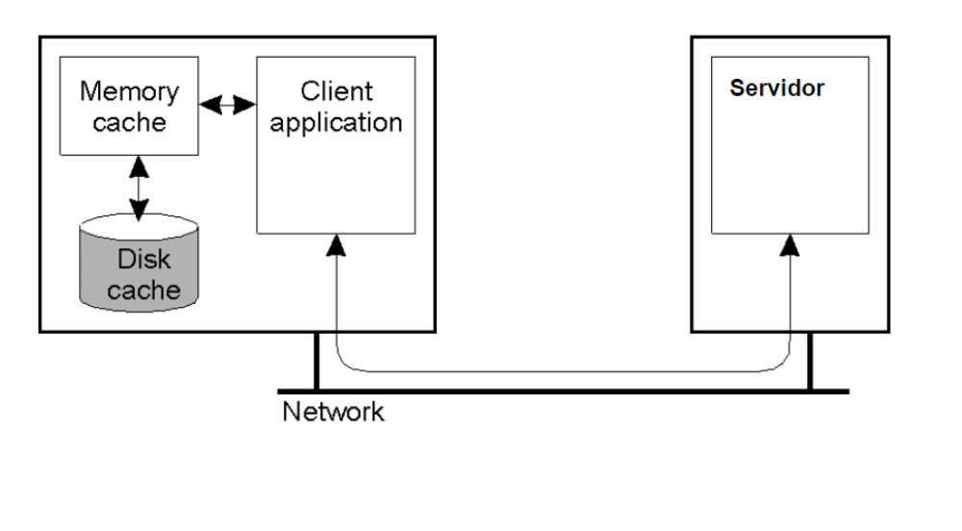
Caching…
cache hit-
for example, a web browser program might check its local cache on disk to see if it has a local copy of the contents of a web page at a particular URL.
The percentage of accesses that result in cache hits is known as the hit rate or hit ratio of the cache.

Slide 26
Caching…
regarding caching there are several key decisions as in distributed systems:
  Granularity of cached data (large versus small)
  Cache size (large versus small, fixed versus dynamically changing)
  Replacement policy
In distributed systems a file-caching scheme should also address the following key decisions:
  Cache location
  Modification propagation
  Cache validation

Slide 27
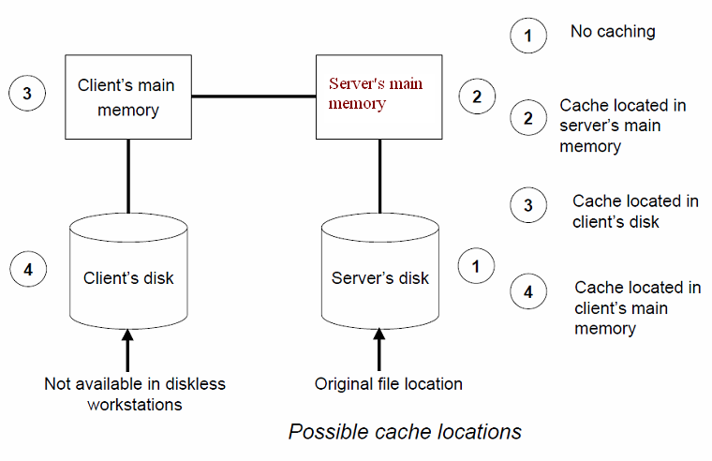
Caching…

Slide 28
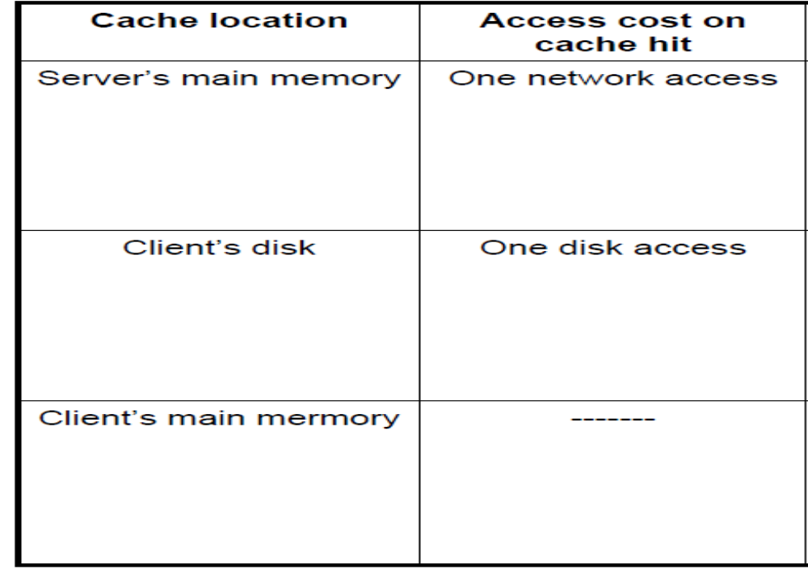
Caching…

Slide 29
Caching…
Modification propagation-
The aim is keeping file data cached at multiple client nodes consistent.
There are several approaches related with:
  When to propagate modifications made to a cached data to the corresponding file server
  How to verify the validity of cached data
The modification propagation used has a critical effect on the system’s performance and reliability.
The file semantics supported depends greatly on the modification propagation scheme used.

Slide 30
Caching…
Write through Scheme.-
When a cache entry is modified, the new value is immediately sent to the server for updating the original copy of the file.
  Advantages: reliability and suitability for UNIX-like semantics.
  Drawback: write-through caches are too expensive to be useful, the consistency of caches will be damaged.
Delayed-Write Scheme.-
  The aim is to reduce network traffic for writes.
  where writes are not propagated to the server immediately, but in the background later on, and write-on-close where the server receives updates only after the file is closed.

Slide 31
Caching…
Delayed-Write Scheme helps in performance improvement for write accesses due the following reasons:
  Write accesses complete more quickly because the new value is written only in the cache , the client performing the write.
  Adding a delay to write-on-close has the benefit of avoiding redundant writes if a file is deleted shortly after it has been closed.
  Gathering of all file updates and sending them together to the server is more efficient than sending each update separately.
However can be some reliability problems. Modifications not yet send to the server from a client’s cache will be lost if the client crashes.

Slide 32
Caching…
Cache Validation Schemes.-
  A file data may simultaneously reside in the cache of multiple nodes.
  The modification propagation policy only specifies when the master copy of a file at the server node is update upon modification of a cache entry.
Client initiated approach.-
  Checking before every access. This approach defeats the main purpose of caching, but it is suitable for supporting UNIX-like semantics.
  Periodic checking. A check is initiated very fixed interval of time.
  Check on file open. With this option, a client’s cache entry is validated only when the client opens the corresponding file for use. It is suitable for supporting session semantics.
Server initiated approach.-
  maintaining a record of which files are cached by which clients.

Slide 33
File Replication
The main approach to improving the performance and fault tolerance of a DFS is to replicate its content.
A replicating DFS maintains multiple copies of files on different servers.
This can prevent data loss, protect a system against down time of a single server, and distribute the overall workload.

Slide 34
File Replication
There are three approaches to replication in a DFS:
Explicit replication : The client explicitly writes files to multiple servers. This approach requires explicit support from the client and does not provide transparency.
Lazy file replication : The server automatically copies files to other servers after the files are written. Remote files are only brought up to date when the files are sent to the server. How often this happens is up to the implementation and affects the consistency of the file state.
Group file replication : write requests are simultaneously sent to a group of servers. This keeps all the replicas up to date, and allows clients to read consistent file state from any replica.

Slide 35
File Replication
Differences between Replication and Caching
  A replica is associated with a server, whereas a cached copy is normally associated with a client.
  The existence of a cached copy is primarily dependent on the locality in file access patterns, whereas the existence of a replica normally depends on availability and performance requirements.
  As compared to a cached copy, a replica is widely known, secure, available, complete and accurate.
  A cached copy is dependent upon a replica. Only by periodic revalidation with respect to a replica can a cached copy be useful

Slide 36
File Replication …
The possible benefits that offer the replication of data are:
  Increased availability
  Increased reliability
  Improved response time
  Reduced network traffic
  Improved system throughput
  Better scalability
  Autonomous operation

Slide 37
Fault tolerance
The fault tolerance is an important issue in the design of a distributed file system. The characteristics of that kind of systems make possible several fault situations.
The primary file properties that directly influence the availability of a distributed system to tolerate faults are:
  Availability. It is a reference about the fraction of the time for which the file is available for use. Replication is a mechanism for improving the availability of a file.
  Robustness. It refers to its power to survive crashes of the storage device.
  Recoverability. Ability to be rolled back to an earlier, consistent state when an operation on the file fails or is aborted by the client.

Slide 38
Distinctions between Stateful vs Stateless service
The file servers that implement a distributed file service can be stateless or stateful.
Failure Recovery-
stateful server
  If a stateful server loses all its volatile state in a crash.
    Restore state by recovery protocol based on a dialog with clients ,or abort operations that were underway when the crash occurred.
    Server needs to be aware of client failures in order to reclaim space allocated to record the state of crashed client processes (orphan detection and elimination).
stateless server
  With stateless server ,the effects of server failures and recovery are almost unnoticeable.
  The main advantage of stateless servers is that they can easily recover from failure. Because there is no state that must be restored, a failed server can simply restart after a crash and immediately provide services to clients as though nothing happened.
  A newly restored server can respond to a self-contained request without any difficulty.

Slide 39
Distinctions between Stateful vs Stateless service ….
Penalties for using the robust stateless service:
  Longer request messages.
  Slower request processing.
  Difficulty in providing UNIX file semantics.
Some environments require stateful service.
  A server utilizing server-initiated cache validation cannot provide stateless service , since it maintains a record of which files are cached by which clients.
  UNIX use of file descriptors and implicit offsets is inherently stateful ;servers must maintain tables to map the file descriptors to inodes ,and store the current offset within a file.

Slide 40
NFS Introduction
NFS was originally developed by Sun for use on its UNIX-based workstations, but has been implemented for many other systems as well.
The basic idea behind NFS is that each file server provides a standardized view of its local file system (each NFS server supports the same model).
This approach allows a heterogeneous collection of processes, possibly running on different operating systems and machines, to share a common file system.

Slide 41
Contd…
NFS version 1, 2, 3 &4.
NFS is not so much a true file system, as a collection of protocols that together provide clients with a model of a distributed file system.
The NFS protocols have been designed in such a way that different implementations should easily interoperate. In this way, NFS can run on heterogeneous collection of computers.
An open standard with clear and simple interfaces.

Slide 42
Cont…
Supports many of the design requirements already mentioned:
  transparency
  heterogeneity
  efficiency
  fault tolerance

Slide 43
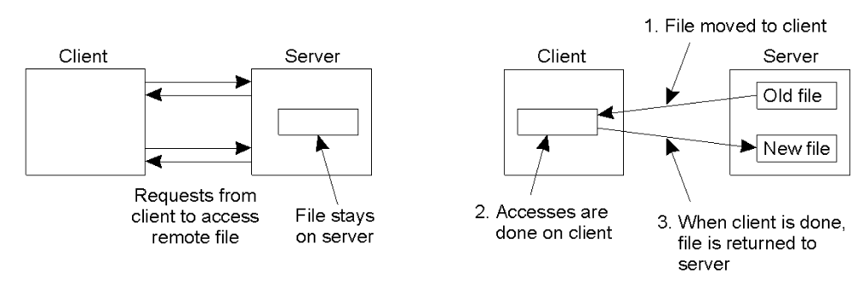
NFS Architecture
(a) The remote access model
(b) The upload/download model

Slide 44
Cont…
There are benefits and drawbacks to both models.
The remote access model -
all operations are performed at the server itself, with clients simply sending commands to the server.
It makes it possible for the file server to order all operations and therefore allow concurrent modifications to the files.
  A drawback is that the client can only use files if it has contact with the file server. If the file server goes down, or the network connection is broken, then the client loses access to the files.
The upload/download model -
files are downloaded from the server to the client. Modifications are performed directly at the client after which the file is uploaded back to the server.
It can avoid generating traffic every time. Also, a client can potentially use a file even if it cannot access the file server.
  A drawback of performing operations locally and then sending an updated file back to the server is that concurrent modification of a file by different clients can cause problems.

Slide 45
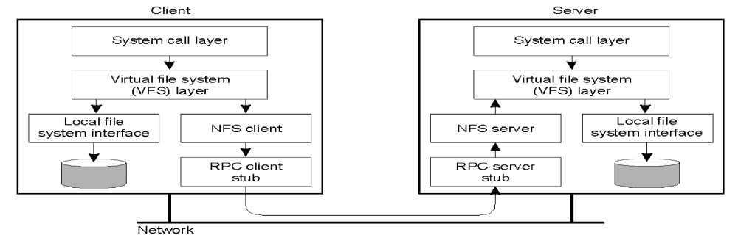
NFS Architecture…
A client accesses the file system using the system calls provided by its local operating system.
The local OS file system interface is replaced by an interface to the Virtual File System (VFS), which is a standard for interfacing to different (distributed) file systems. The whole idea of the VFS is to hide the differences between various file systems.
Operations on the VFS interface are either passed to a local file system, or passed to a separate component known as the NFS Client, which takes care of handling access to files stored at a remote server.
In NFS all, client -server communication is done through RPCs.
On the server side, the NFS server is responsible for handling incoming client request. The RPC stub unmarshals requests and the NFS server converts them to regular VFS file operations that are subsequently passed to the VFS layer.

Slide 46
NFS Architecture…
An important advantage of this scheme is that NFS is largely independent of local file systems.
It really does not matter whether the operating systems at the client or server implements a UNIX file system, a Windows 2000 file system, or even an old MS-DOS file system.
The only important issue is that these file systems are accommodating with the file system model offered by NFS.

Slide 47
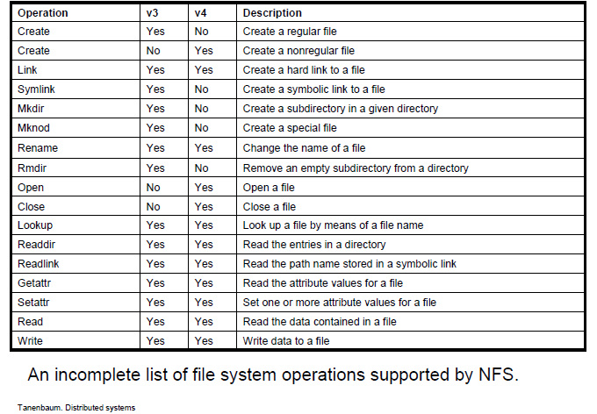
File System Model

Slide 48
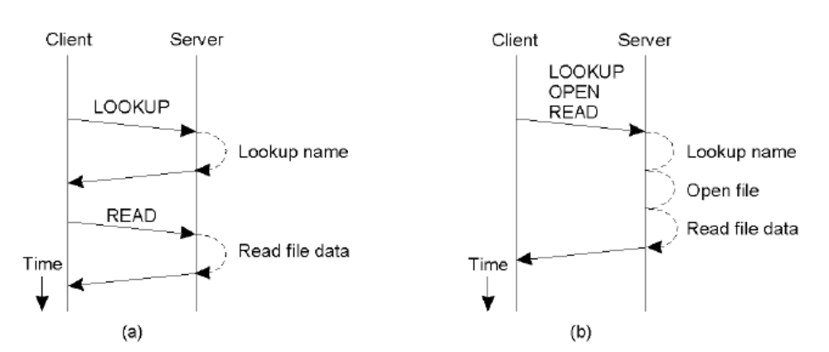
Communication
Reading data from a file in NFS version 3.
Reading data using a compound procedure in version 4. By this procedure several RPCs can be grouped into a single request.

Slide 49
NFS. Characteristics
Stateless server, so the user's identity and access rights must be checked by the server on each request.
  In the local file system they are checked only on open()
Every client request is accompanied by the user ID and group ID
Server is exposed to imposter attacks unless the user ID and group ID are protected by encryption
Kerberos has been integrated with NFS to provide a stronger and more comprehensive security solution
  Mount operation:
    Mount ( remotehost, remotedirectory, localdirectory)
  Server maintains a table of clients who have mounted file systems at that server
  Each client maintains a table of mounted file systems holding:
< IP address, port number, file handle>
“File handle a number that the operating system assigns temporarily to a file when it is opened. The handle is used throughout the session to access the file. A special area of main memory is reserved for file handles, and the size of this area determines how many files can be open at once.”

Slide 50
NFS Naming
The fundamental idea underlying the NFS naming model is to provide clients complete transparent access to a remote file system as maintained by a server.
This transparency is achieved by letting a client be able to mount a remote file system into its own local file system.
Instead of mounting an entire file system, NFS allows client to mount only part of a file systems.
This design approach has a serious implication: in principle, users do not share name spaces. The drawback of this approach in a distributed file system, is that sharing files much harder.

Slide 51
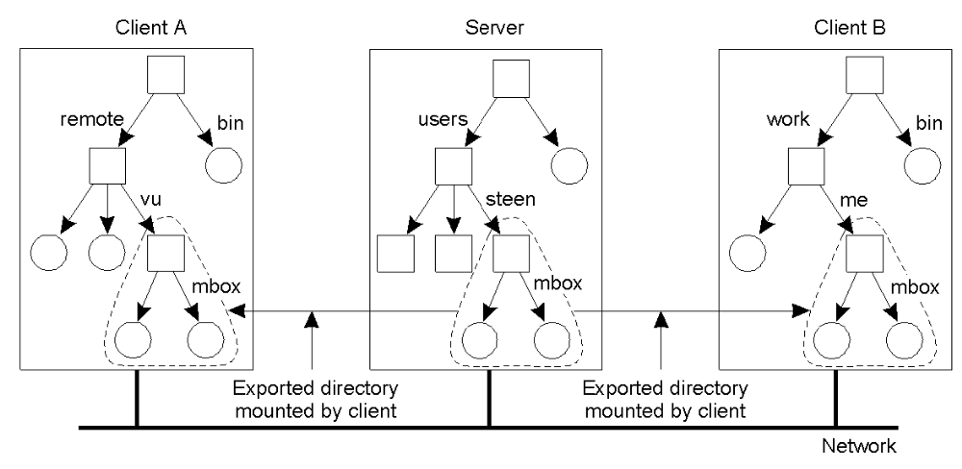
NFS Naming
Mounting (part of) a remote file system in NFS

Slide 52
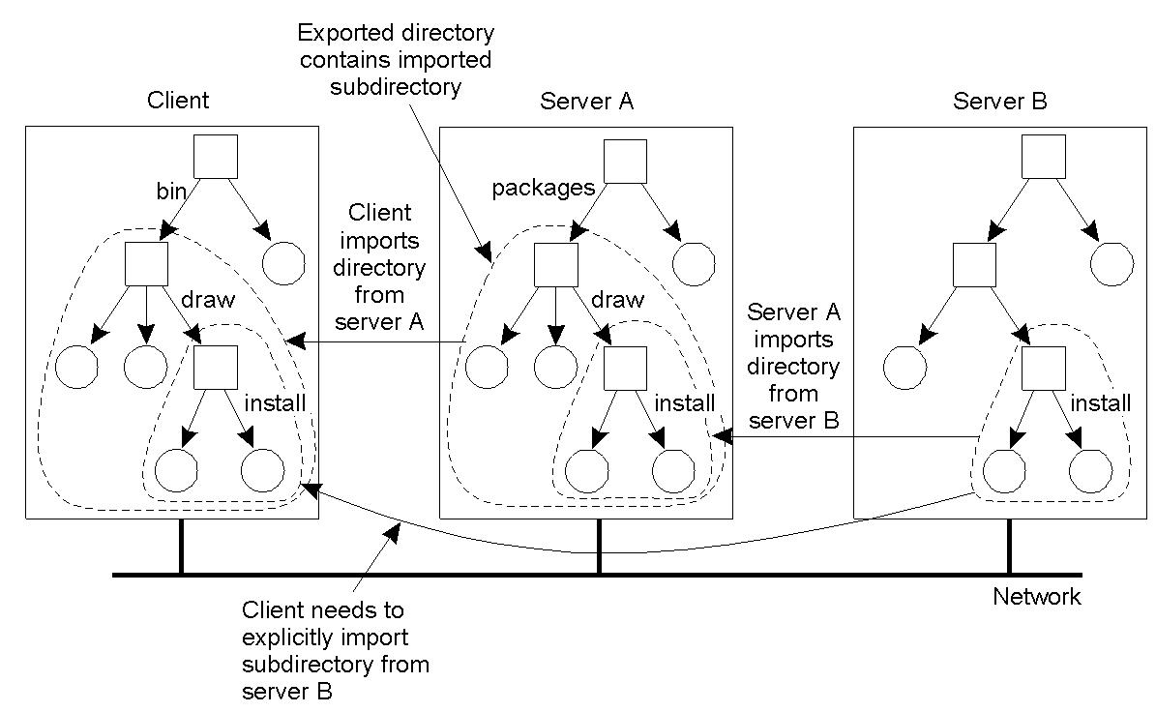
NFS Naming
Mounting nested directories from multiple servers in NFS
An NFS server can not itself mount directories that are exported by other servers. However, it is not allowed to export those directories to its own clients.
Instead, a client will have to explicitly mount such a directory from the server that maintains it.
This restriction comes from simplicity. If a server could export a directory that is mounted from another server, it would have to return special file handles that include an identifier for a server. NFS does not support such file handles.

Slide 53
NFS. Automounting
Problem with the NFS naming model has to do with deciding when a remote file system should be mounted.
Consider a large system with thousands of users. Assume that each user has a local directory /home that is used to mount the home directories of other users.
  For Example: - Alice’s home directory may be locally available to her as /home/Alice, although the actual files are stored on a remote server. This directory can be automatically mounted when Alice logs into her workstation.
for every user, logging in could incur a lot of communication and administrative overhead. In addition, it would require that all users are known in advance.
On demand mounting of a remote file system is handled in NFS by an automunter, which runs as a separate process on the client machine. The principle underlying an automounter is relatively simple.

Slide 54
Cont…
By considering a simple automounter, assume that for each user, the home directories of all users are available through the local directory /home.
  When a client machine boots, the automounter starts with mounting this directory.
The effect of this local mount is that whenever program attempts to access /home, the OS kernel will forward a lookup operation to the NFS client, which in this case, will forward the request to the automounter in its role as NFS server, as shown in below figure.

Slide 55
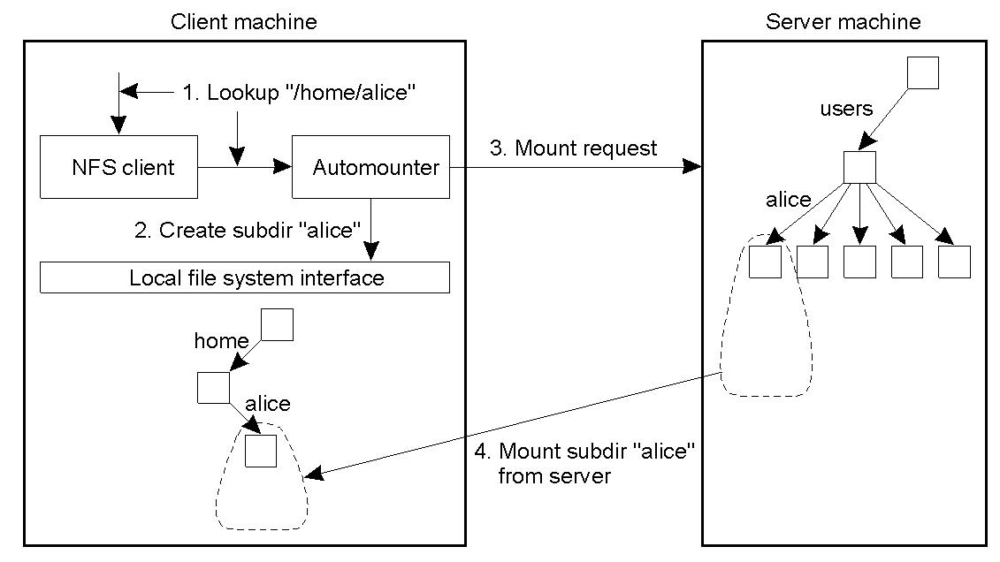
Cont…

Slide 56
Cont…
Automounter first creates a subdirectory /alice in /home . it then looks up the NFS server that exports Alice’s home directory to subsequently and mount that directory in /home/alice. At that point, the login program can proceed.
A simple solution is to let the automounter mount directories in a special subdirectory, and install a symbolic link to each mount directory. This approach is shown in below figure.

Slide 57
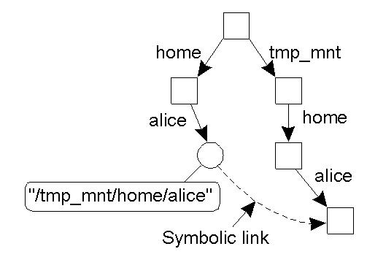
Cont…

Slide 58
Cont…
In the figure (last slide), the user home directories are mounted as subdirectories of /tmp_mnt. When Alice logs in , the automounter mounts her home directory in /tmp_mnt/home/alice and creates a symbolic link /home/alice that refers to that subdirectory.
The NFS server that exports Alic’s home directory in contacted directory without further involment of automounter.

Slide 59
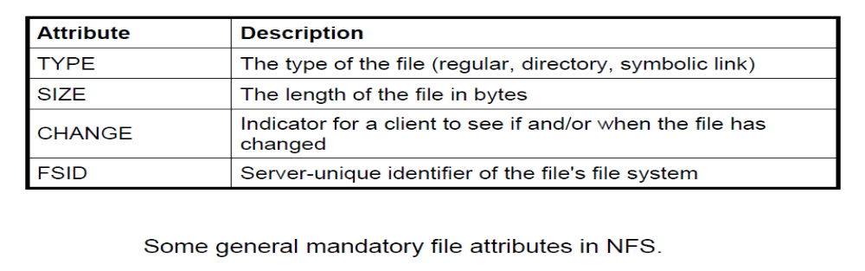
NFS. File Attributes
An NFS file has a number of associated attributes. In version 3, the set of attributes was fixed and every implementation was expected to support those attributes. With version 4, the set of file attributes has been split into a set of mandatory attributes that every implementation must support, a set of recommended attributes that should be preferably supported, and an additional set of named attributes.

Slide 60
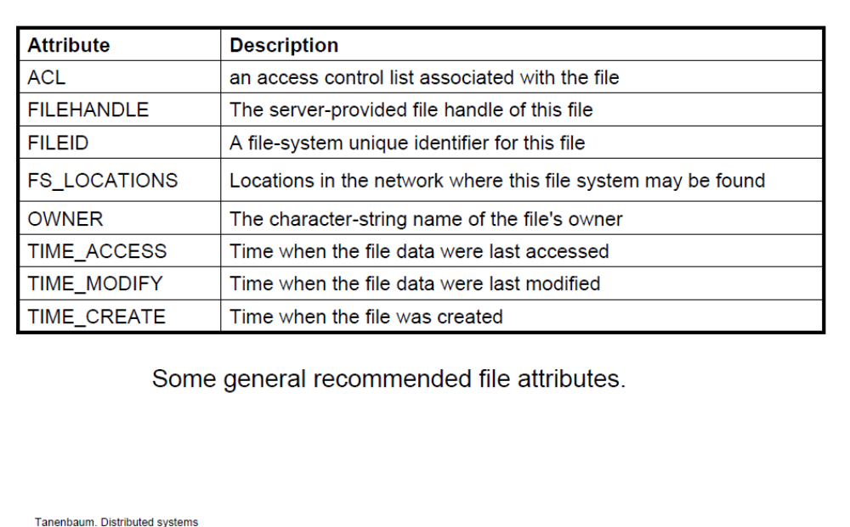
Cont…

Slide 61
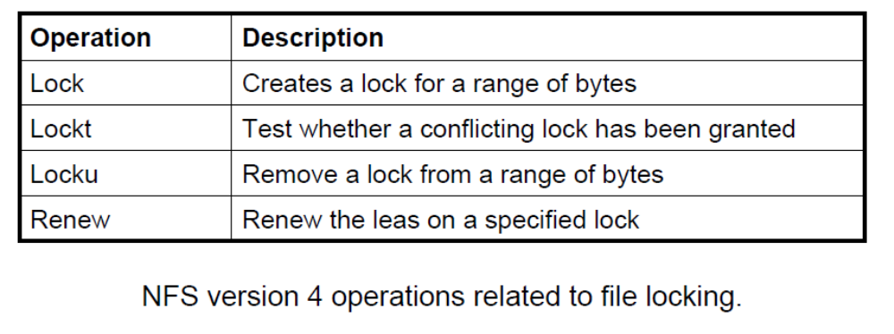
Synchronization: File Locking in NFS
NFS distinguishes read locks from write locks. Multiple clients can simultaneously access the same part of a file provided they only read data. A write lock is needed to obtain limited access to modify part of a file.
Lock operation is used to request a read or write lock on a consecutive range of bytes in a file. if the lock cannot be granted due to another conflicting lock, the client gets back an error message and has ask the server at a latter time. The client request to be put on a FIFO-ordered list maintained by the server. As soon as conflicting lock has been removed, the server will grant the next lock to the client at the top of the list.
Removing a lock from a file is done by means of locku operation.
Using the renew operation, a client requests the server to renew the lease on its lock.

Slide 62
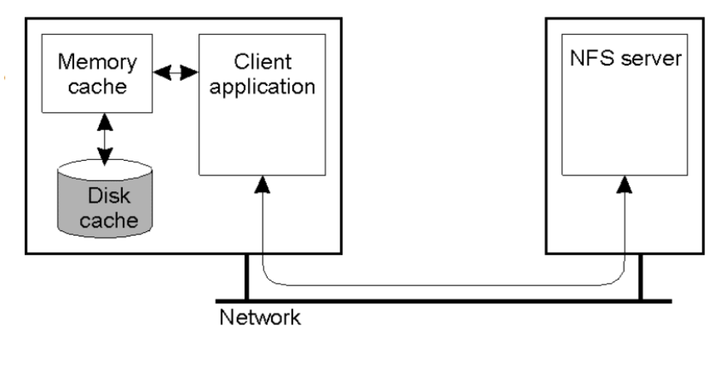
NFS Client Caching

Slide 63
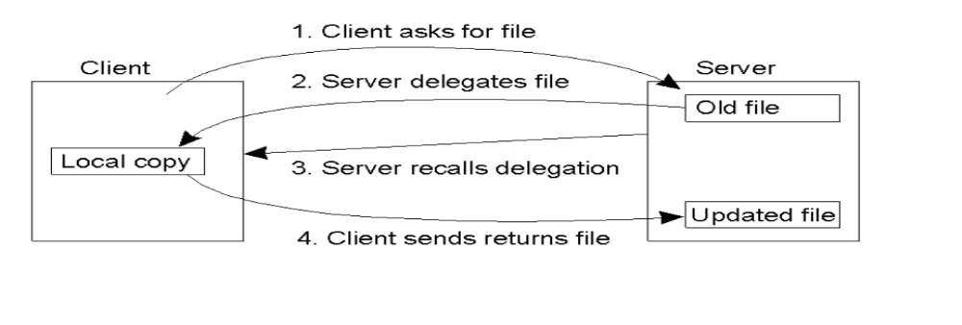
NFS Client Caching
A server may delegate some of its rights to a client when a file is opened.
An important consequence of delegating a file to a client is that the server needs to be able to recall the delegation, for example,
  when another client on a different machine needs to obtain access rights to the file. Recalling a delegation requires that the server can do a callback to the client.

Slide 64
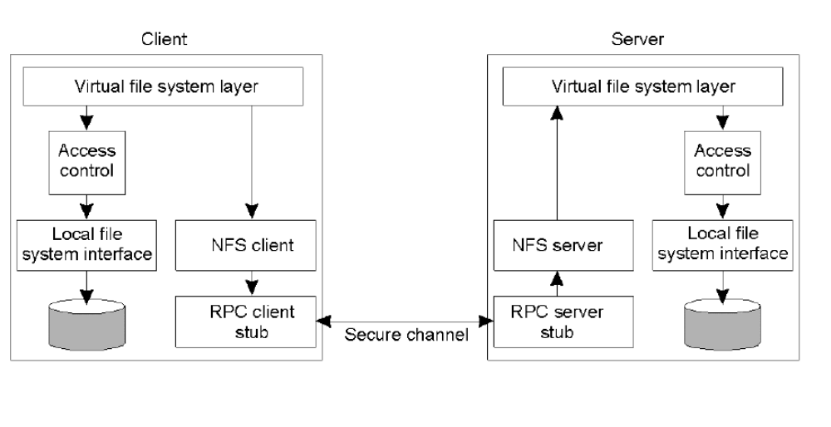
NFS The security architecture

Slide 65
Cont…
Security:
Traditionally (NFS v3), clients were trusted. Three ways of authentication:
  System authentication
Client passes user ID and group ID to server.
(i.e., almost no security)
  Secure NFS using Diffie-Hellman (public key crypto)
    More complex (implementation and key management)
  Kerberos
    Secure
    Entry costs
Enhanced security with NFS v4:
  RPCSEC_GSS as general security framework
    Message integrity and confidentiality

Slide 66
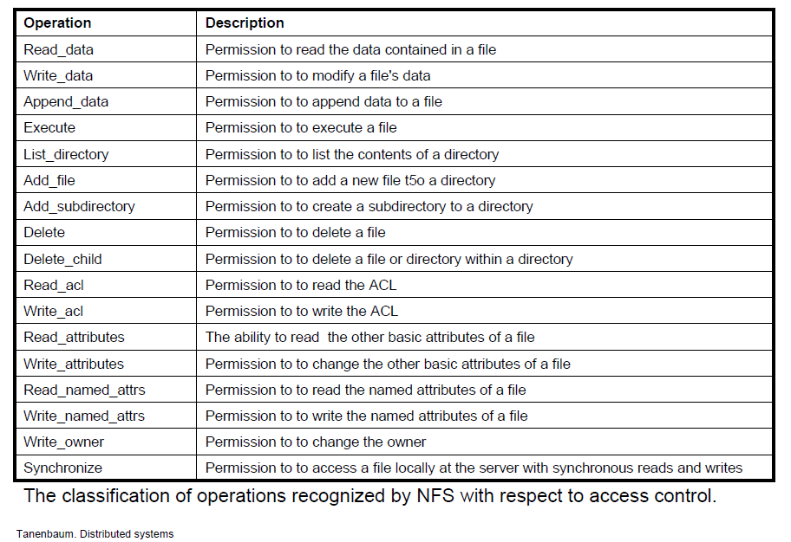
NFS. Access Control

Slide 67
NFS. Scalability
The performance of a single server can be increased by the addition of processors, disks and controllers.
When the limits of that process are reached, additional servers must be installed and the file systems must be reallocated between them.
When loads go beyond the maximum performance, a distributed file system that supports replication of updatable files,
  or one that reduces the protocol traffic by the caching of whole files, may offer a better solution.

